Slide 1



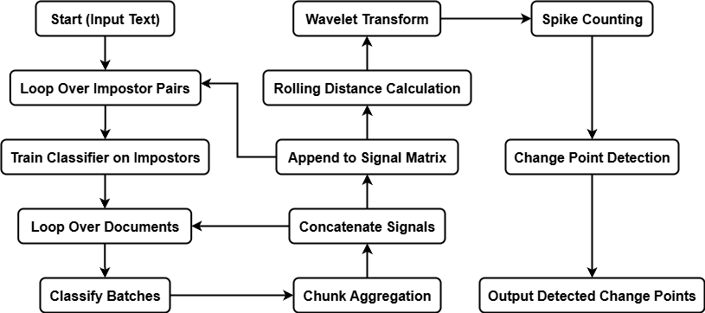
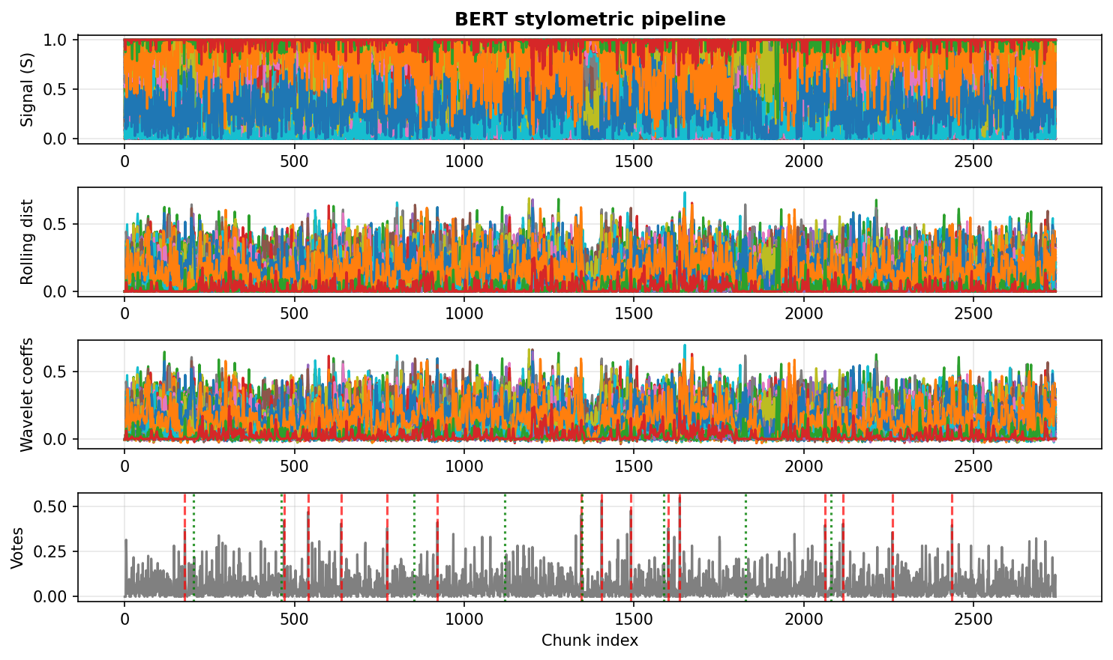
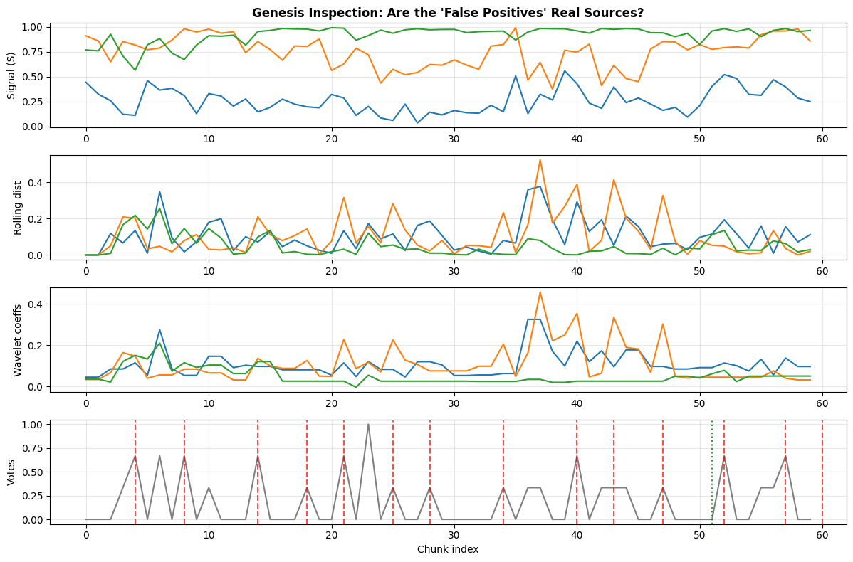
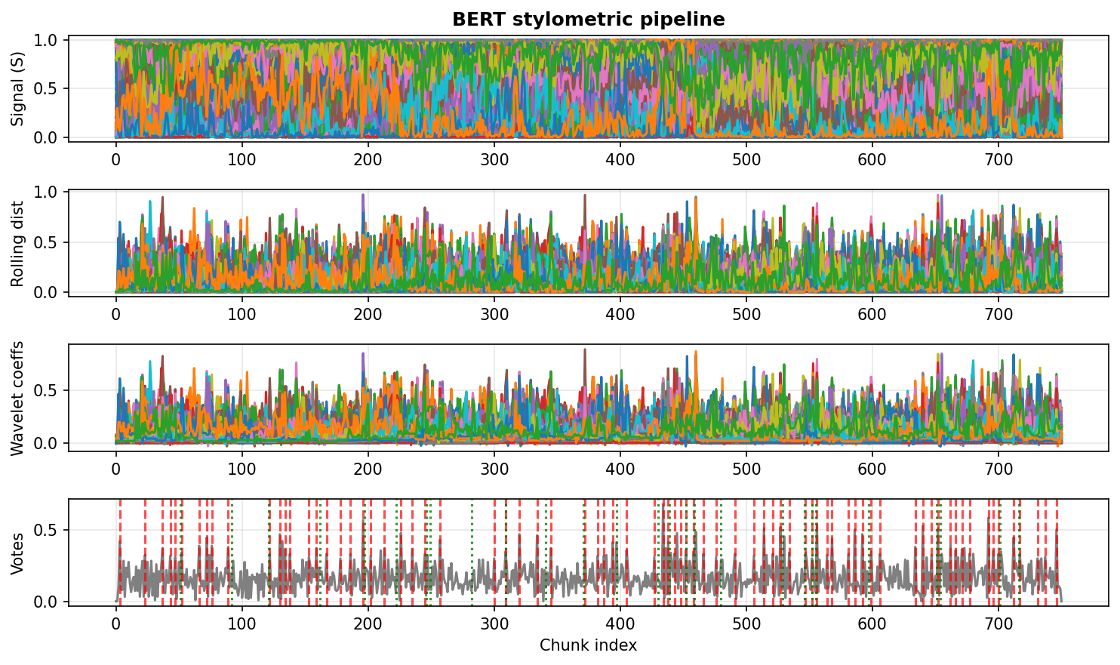

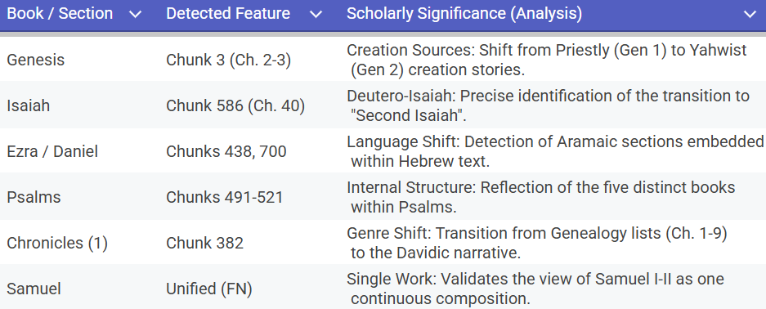
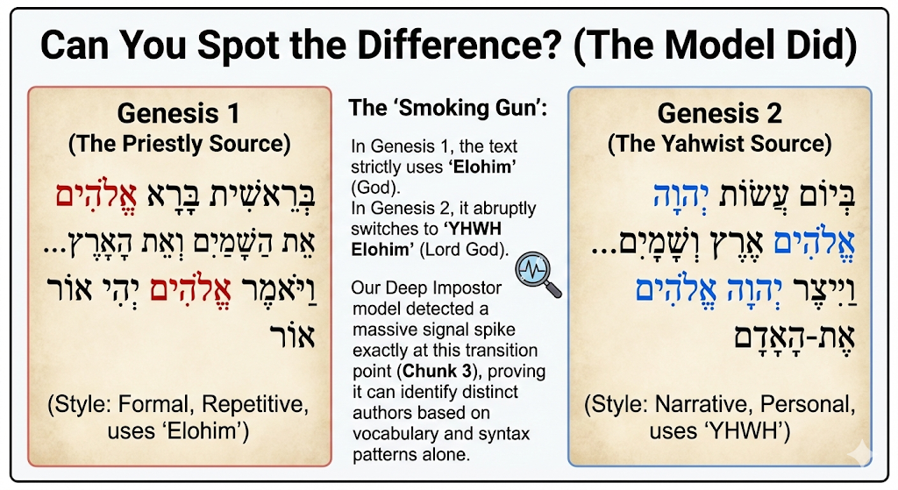
Literature Sources Analysis Using a Deep Impostor Approach
Team Code: 25-2-R-13, Ofir Uziel, Emanuel Davidov
Advisors: Dr. Renata Avros and Prof. Zeev Volkovich, Braude College of Engineering
Motivation: Why Internal Style Matters
Most stylometric methods assume single-author, homogeneous documents.
Real texts are often edited, compiled, or written over long periods.
Internal stylistic variation is therefore ignored or treated as noise.
Labeled data for stylistic boundaries is rarely available.
There is a need for an unsupervised system that detects internal stylistic changes.
System Goal and Core Idea
Goal: Detect internal stylistic boundaries in long texts without supervision.
No training is performed on the target document.
Models are trained only on unrelated impostor texts.
Classifier behavior is interpreted as a stylistic response.
Classifier behavior functions as a stylistic sensor rather than a predictor.
System Architecture
The system consists of four modular components:
Text Segmentation Fixed-length batching and chunking of documents.
Embedding Module Word2Vec or BERT representations.
Stylistic Classification Deep binary classifiers trained on impostor pairs.
Signal Analysis Signal construction and boundary detection
Pipeline Execution
Target text is segmented and embedded.
Impostor-pair classifiers process each chunk.
Outputs form continuous stylistic signals.
Signal refinement emphasizes stylistic transitions.
Consensus across impostors produces final boundaries.
Raw text is transformed into a 1D stylistic signal.
Validation: Proving the Method Works
Validation performed before applying the method to Tanach.
Shakespeare corpus provides expected stylistic variation.
No training on Shakespeare texts.
Clear stylistic transitions are detected.
Confirms detection of genuine stylistic change, not noise.
Conceptual Signal Analysis
Each curve corresponds to a different impostor-pair classifier.
Signals differ in scale but reflect the same text region.
Flat regions indicate stylistic stability.
Aligned changes indicate potential boundaries.
Stylistic structure emerges from agreement across signals.
Final Results
The entire Tanach was analyzed as one continuous text.
The system automatically identified points where writing style changes.
Only a small number of clear boundaries were detected.
These boundaries are consistent and easy to interpret.
The final output is an unsupervised stylistic segmentation of the Tanach.
Challenges and Constraints
High computational cost due to multiple deep classifiers.
Sensitivity to chunk size and segmentation choices.
Tradeoff between noise suppression and boundary resolution.
Design choices required balancing robustness and detail.
Conclusion
The Deep Impostor model identified multiple internal stylistic transitions.
Without prior linguistic training, the system distinguished Hebrew and Aramaic passages.
Detected boundaries aligned with well-known scholarly observations, including:
stylistic divisions within Isaiah, separations between narrative and genealogical sections, and differences between poetic and prose structures.
These results show that unsupervised deep learning can serve as a data-driven tool for exploring textual structure in digital philology.

